Slide 1


Looking for a good time? Adopt a shelter dog.
Code Fellows – Code 301 – January 19, 2019
Notes:
All you need is love … And a dog, Looking for a good time? Adopt a shelter dog.

Slide 2

Create a website that allows the user to see a selection of photos of adoptable dogs in their area and save them to a list where they can review more detailed information and contact the rescue organization
Problem
Domain

Slide 3

Access the Petfinder API to get a list of dogs near the provided location. Render the dogs to the page and use jTinder to allow the user to use “Tinder-Like” Swipe Functionality to like/dislike viewed dogs.
Solution
Domain

Slide 4

Looking for a good time? Adopt a shelter dog.
Application Demonstration
Notes:
All you need is love … And a dog, Looking for a good time? Adopt a shelter dog.

Slide 5
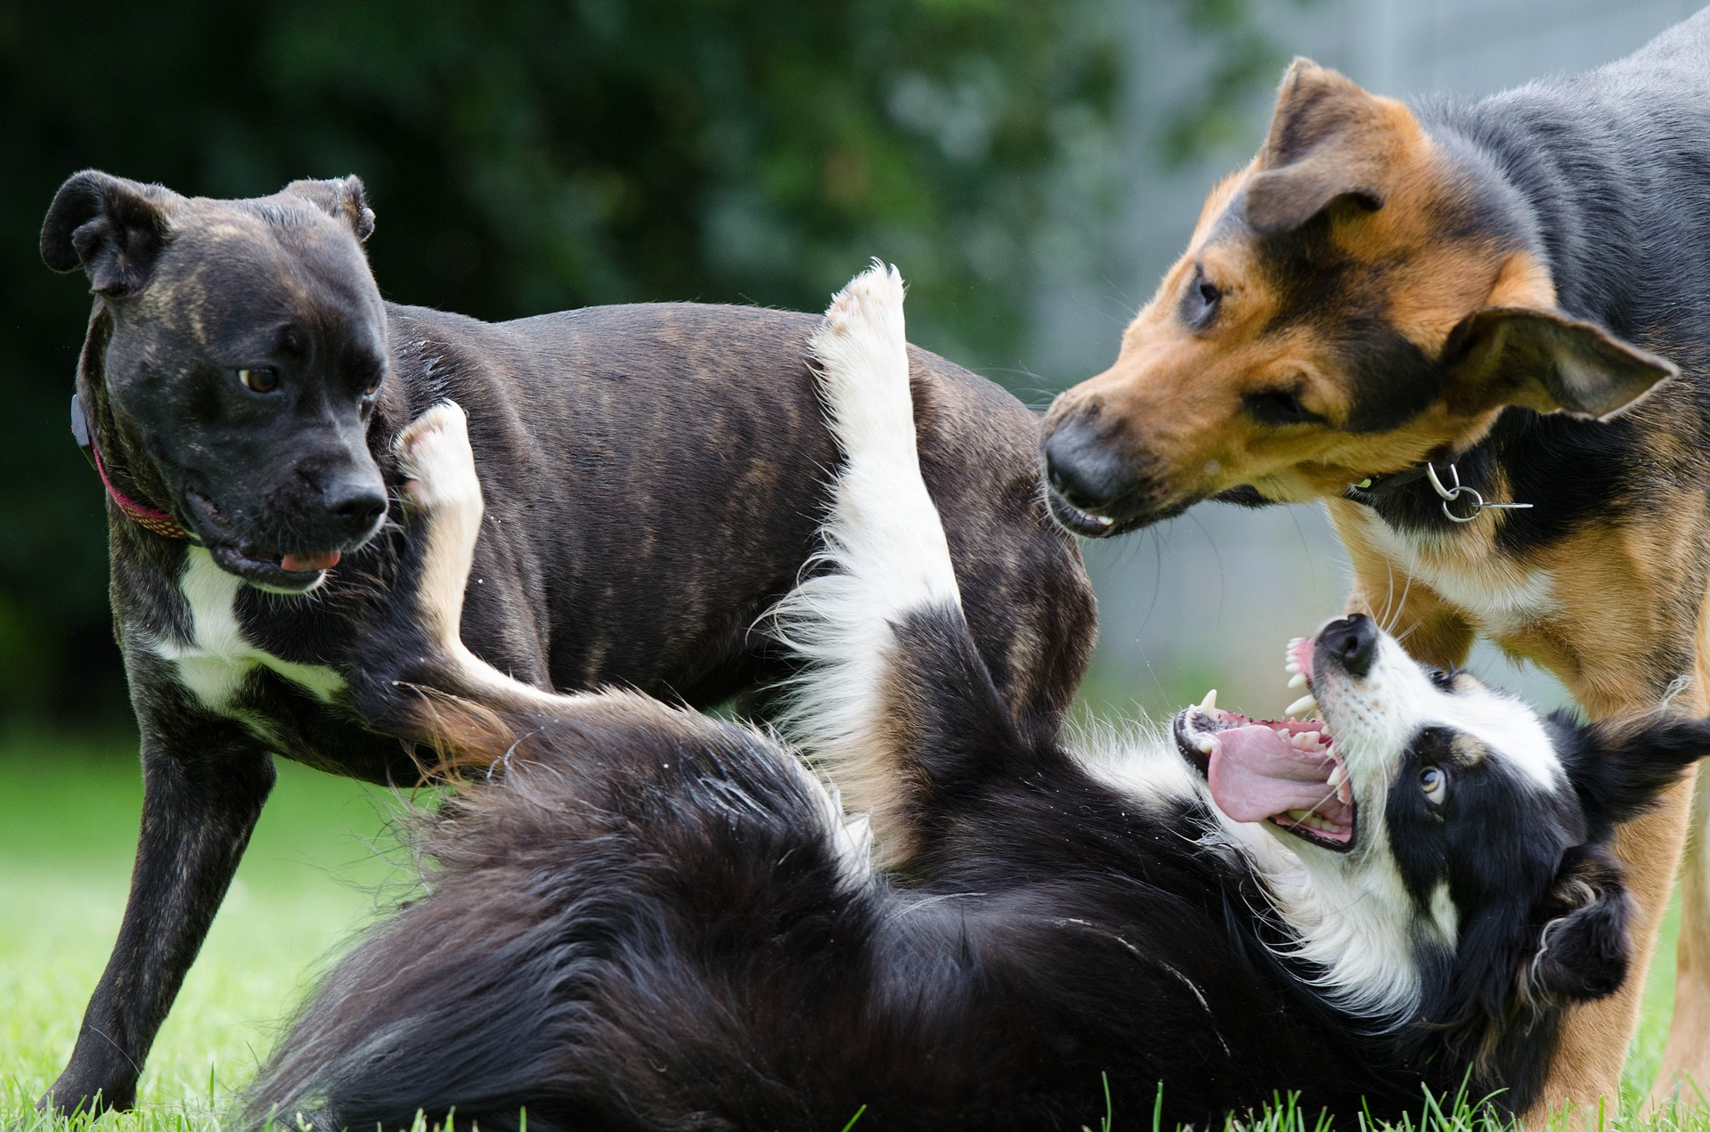
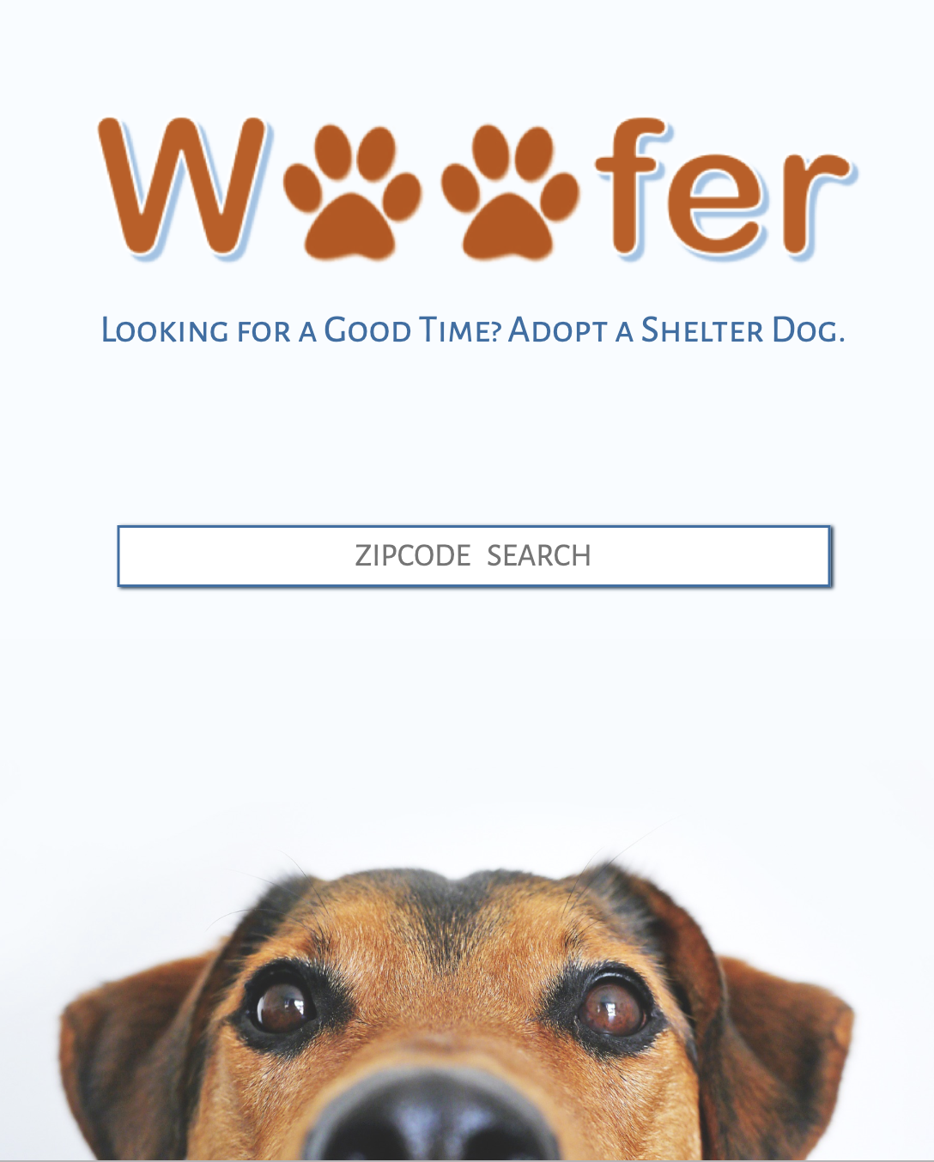
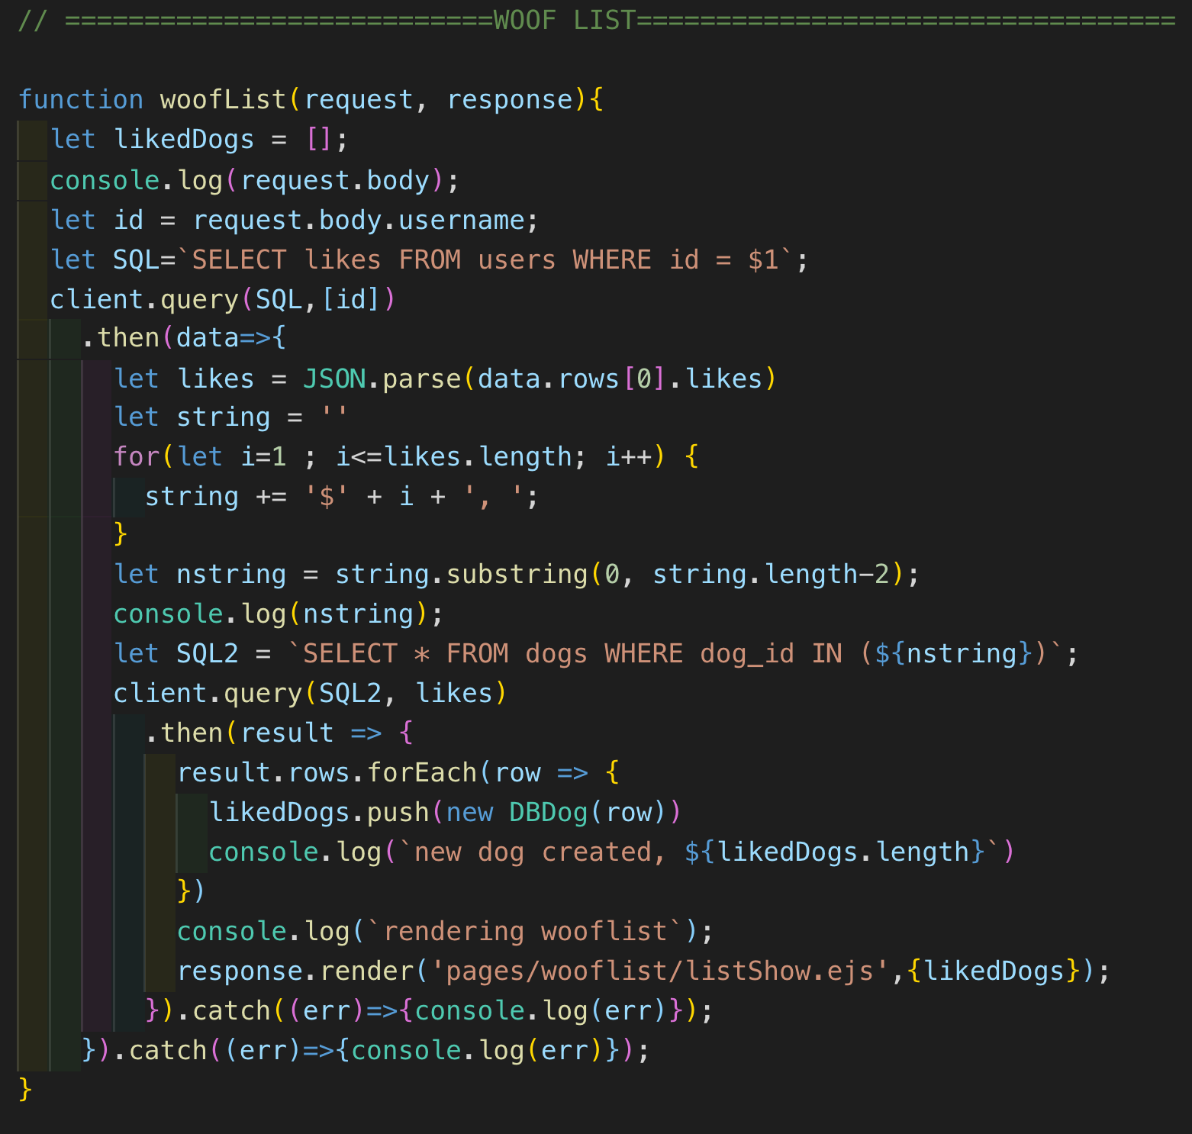
Communication and Division of Work
Front End
Back End

Slide 6


Project Organization

Slide 7
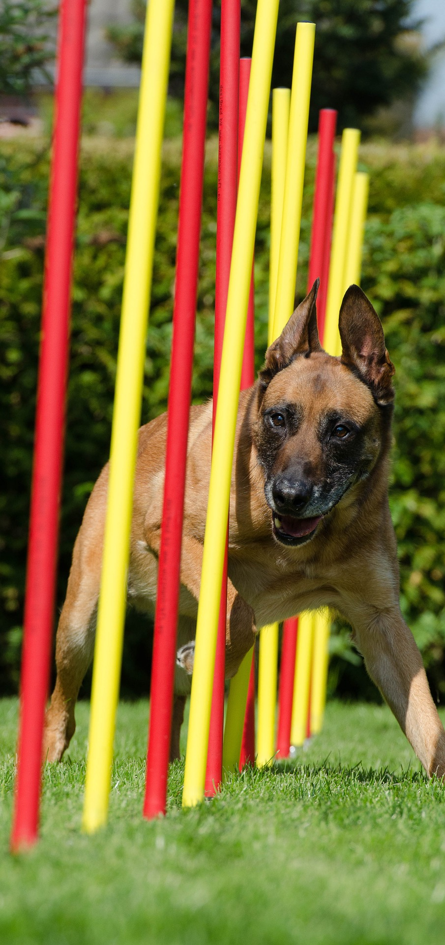
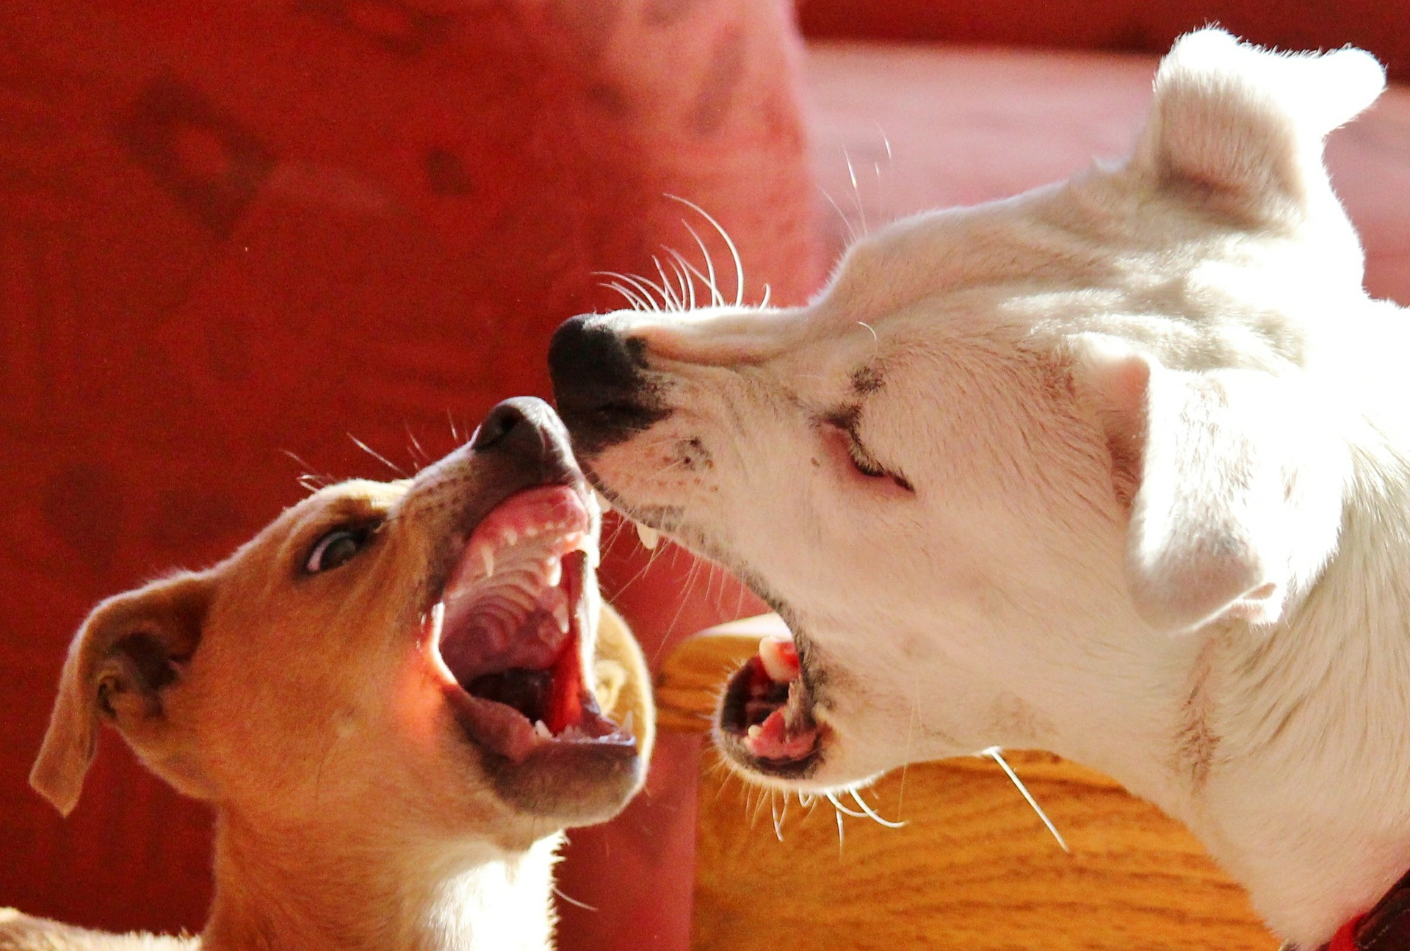
Obstacles
jTinder Library Utilization
Integration of multiple CSS sources
Getting a user ID from local storage without login functionality
Merge Conflicts!!!

Slide 8
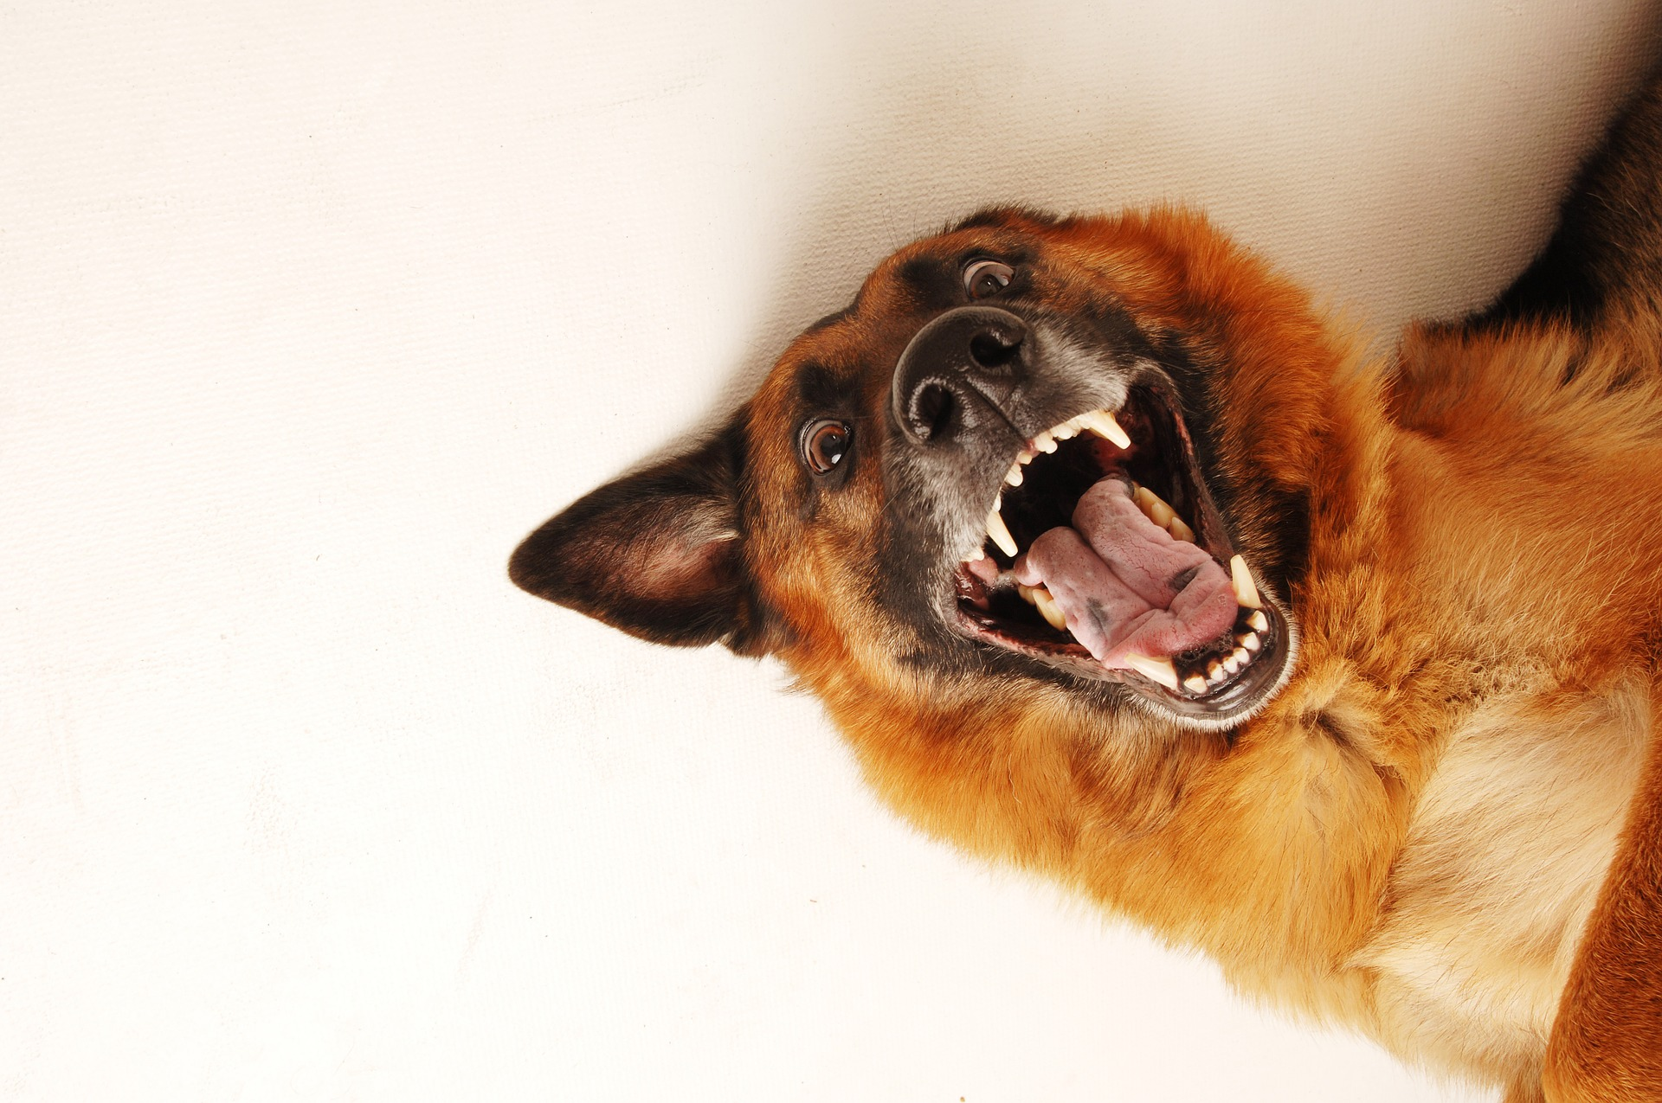
Accomplishments
Clear and logical WRRC
Great Team Communication
Implemented the jTinder Library
Created a Dynamic Front End User Interface

Slide 9


SUPERAGENT
shelters
Home Page
Woof List
Dog Detail
Delete Dog
Search Results
Swipe!
About Team
dogShow.ejs
Find Dog
INDEX.EJS
Client.Query
About.EJS
LIKED Dogs ->
Viewed Dogs ->
WRRC
listSHow.EJS
listShow.ejs
Look for likes
Get Dogs
Dog Info
Petfinder Database
Our Database
Our Server
dogDetail.ejs
shelters
SUPERAGENT

Slide 10

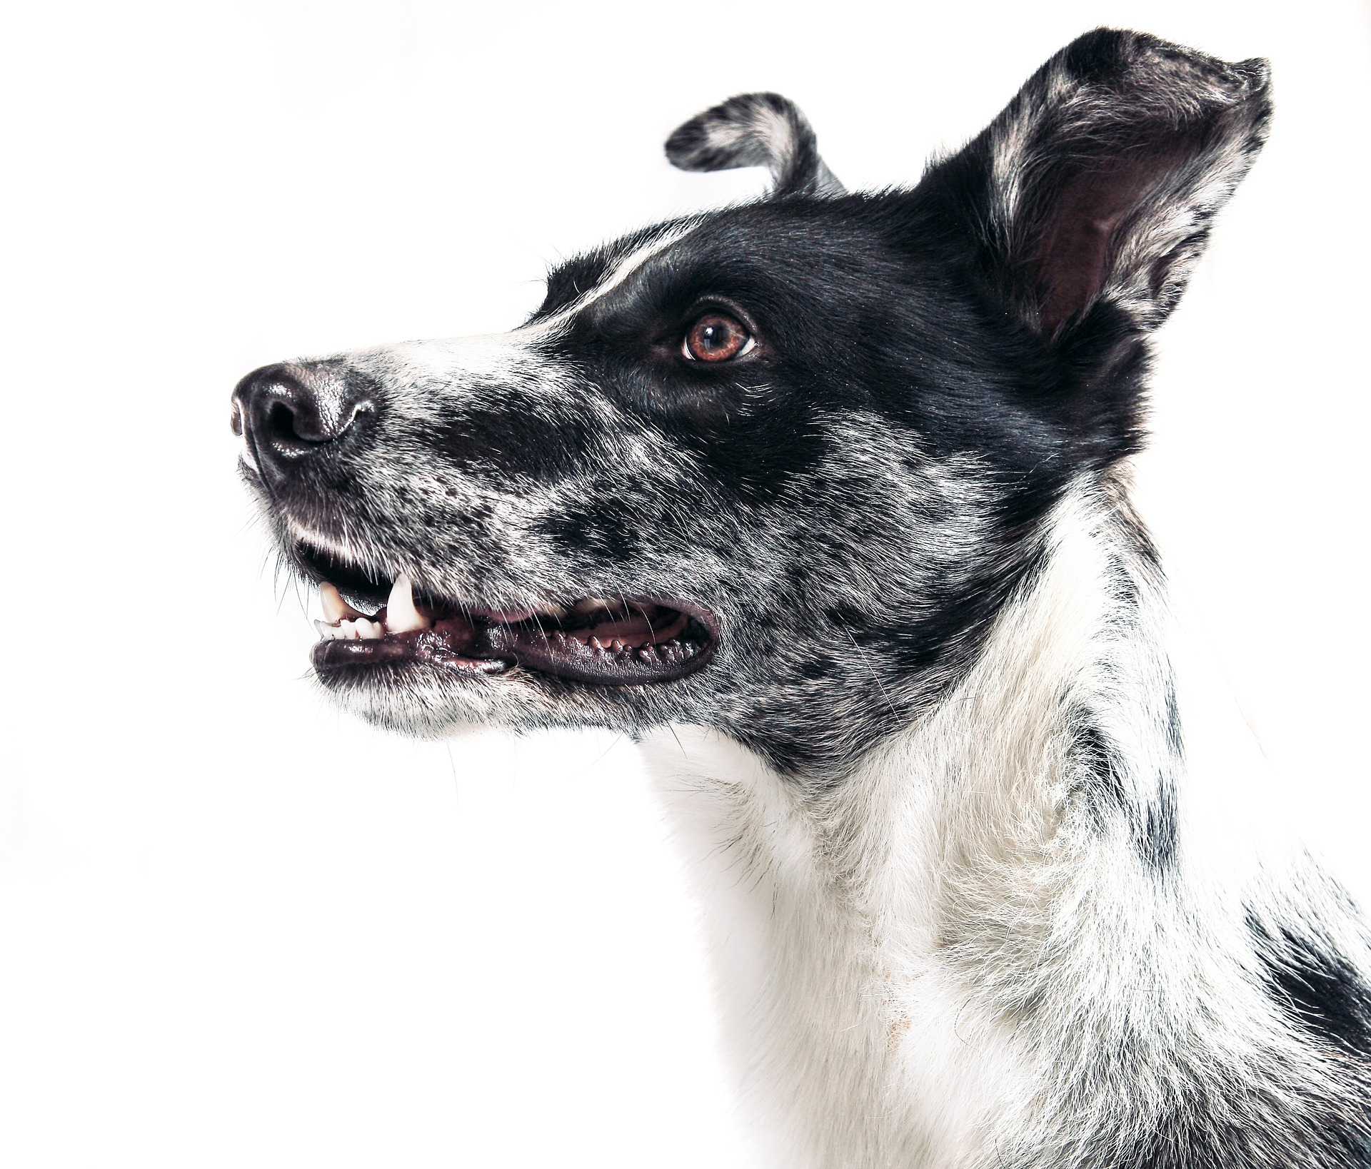
Future Functionality
Improve speed of interactions with database
Cache Invalidation and Update for saved dogs
Expand to other Animal Types
Create a user profile and filter searches
Responsive on all devices
100% Keyboard Accessible Application

Slide 11
Questions?

